Slide 1
Similar oil well detection intelliware
Notes:
تحلیل متن با استفاده از درخت مفهومی جمله-
پردازش زبان طبیعی

Slide 2

Outline
What is the purpose?
What is similarity?
Why similarity?
Similarity detection workflow
Similarity detection Issues

Slide 3
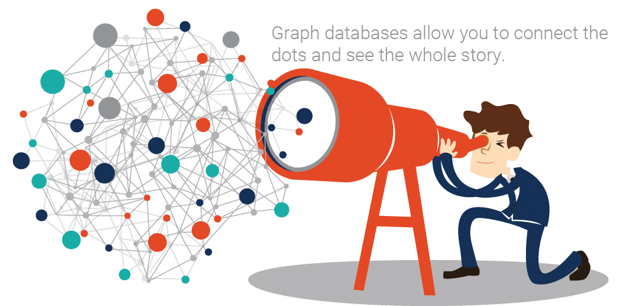
What is The Goal?

Slide 4
What is Similarity?
Numerical measure of how alike two data objects are
Is higher when objects are more alike
Often falls in the range [0,1]

Slide 5
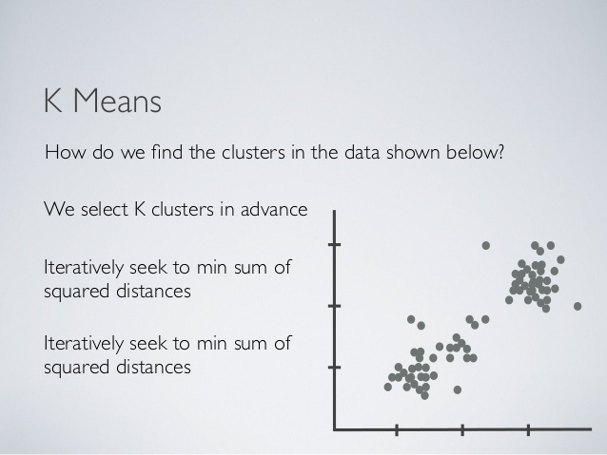


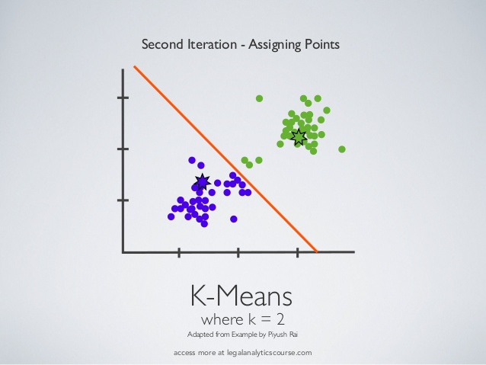
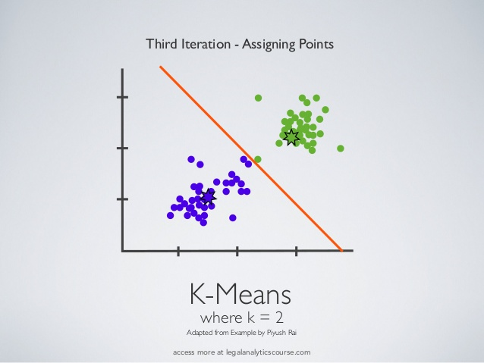

Slide 6
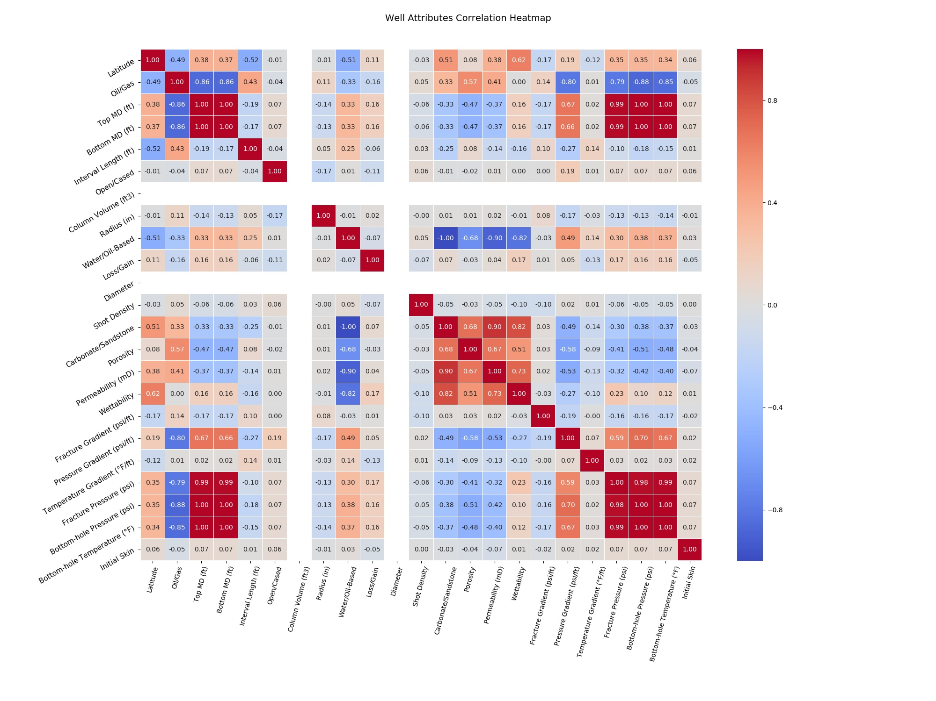

Slide 13

What is NLP?
NLP
Computer science
Artificial intelligence
Linguistics
Goal: For computers to process and “Understand” natural language in order to perform tasks that are useful
Applications:
Spell checking
Machine Translation
Q&A
…
Notes:
علوم رایانه
هوش مصنوعی
زبان شناسی
هدف: فهمیدن، انجام کارهای تحلیلی مفید
بعدی» مقدمه‌ای بر پردازش زبان طبیعی

Slide 14

What is Sentiment Analysis?
Determine the attitude of a speaker or writer
The attitude may be a judgment or evaluation
Example:
I like …. . *
I hate … . *

Slide 15

Why Sentiment Analysis?
Extremely useful in social media monitoring
Overview of the wider public opinion behind certain topics
Extract insights from social data

Slide 16

Kinds of Sentiment Analysis
Document Level Analysis
Paragraph Level Analysis
Sentence Level Analysis
Aspect-based Analysis

Slide 17
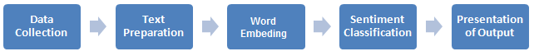
Sentiment Analysis Flowchart
Data Collection
Text Preparation
Word Embedding
Sentiment Classification
Presentation of Output

Slide 18
Sentiment Analysis Issues
Word Embedding
How do we represent words as a vector?
Classification
How do we map a sentence to a class?
Sentences are often unstructured !

Slide 19
Related works
Word embedding
One hot vector
Co-occurrence Matrix
Word2vec (Tomas Mikolov, et al. 2013)
Text Analysis
Bag of Word (Pang & Lee, 2008)
Structure learning
Recurrent neural networks (Socher, 2011)
Matrix-Vector RNNs (Socher, 2012)
RNTN (Socher, 2013)
Notes:
Opinion Mining and Sentiment Analysis(2008)
From machine learning to machine reasoning(2012)

Slide 20
Related works
Word embedding
One hot vector
Co-occurrence Matrix
Word2vec (Tomas Mikolov, et al. 2013)
Text Analysis
Bag of Word (Pang & Lee, 2008)
Structure learning
Recurrent neural networks (Socher, 2011)
Matrix-Vector RNNs (Socher, 2012)
RNTN (Socher, 2013)
Notes:
Vecavg > 73.3
RNN > 79.0
RNTN > 80.7

Slide 21
Related works
Bag of Words (BoW)
Idea: Sentence is sum of words
Ignores sentence structure
A simplistic look
Frequent failure is negation
most BoW models will classify as positive sentiment
Example:
The film lacks intelligence and humor

Slide 22
Related works
Word embedding
One hot vector
Co-occurrence Matrix
Word2vec (Tomas Mikolov, et al. 2013)
Text Analysis
Bag of Word (Pang & Lee, 2008)
Structure learning
Recursive Neural Networks (Socher, 2011)
Matrix-Vector RNNs (Socher, 2012)
RNTN (Socher, 2013)
Notes:
Vecavg > 73.3
RNN > 79.0
RNTN > 80.7

Slide 23
Model classes
neutral
Positive
Somewhat positive
Negative
Somewhat Negative
Notes:
تشخیص قطیبت جملات و نگاشت آنها به 5 طبقه

Slide 24
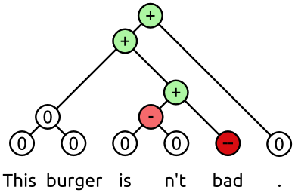
Tree structure

Slide 25
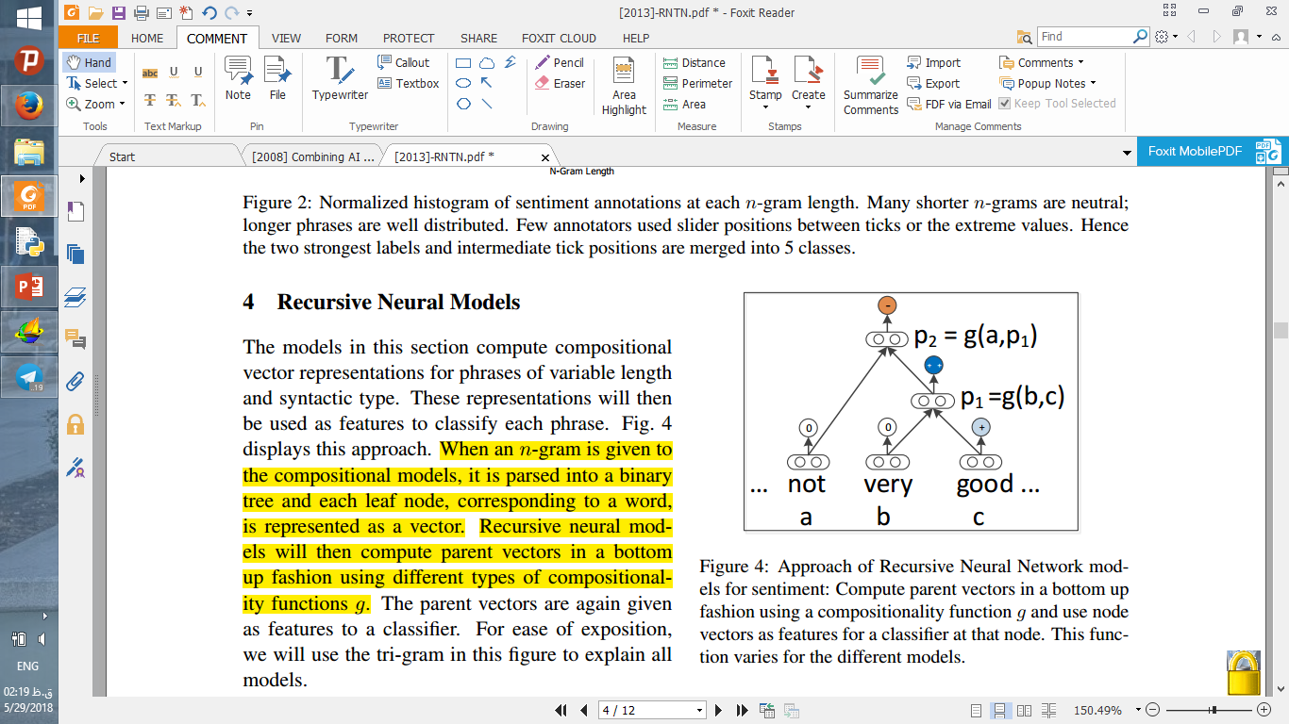
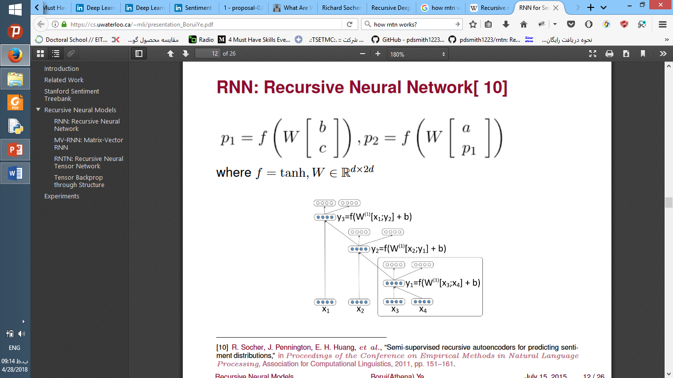
Recursive Neural Network
Simplest model
Single neural network layer
Input is two concatenated word vectors
Notes:
عبارت > درخت باینری > وکتور کلمه
پدر هر گره توسط یک پروسه پایین به بالا با تابع ترکیب مختلف ساخته میشود

Slide 26
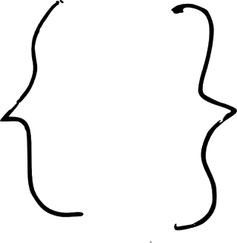
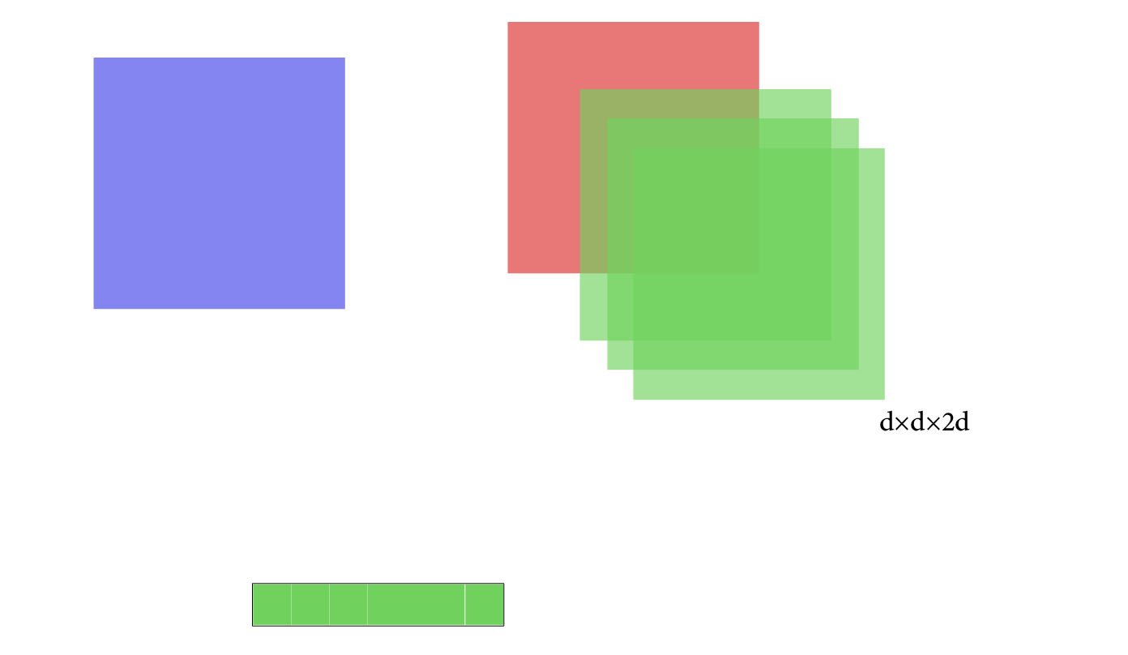
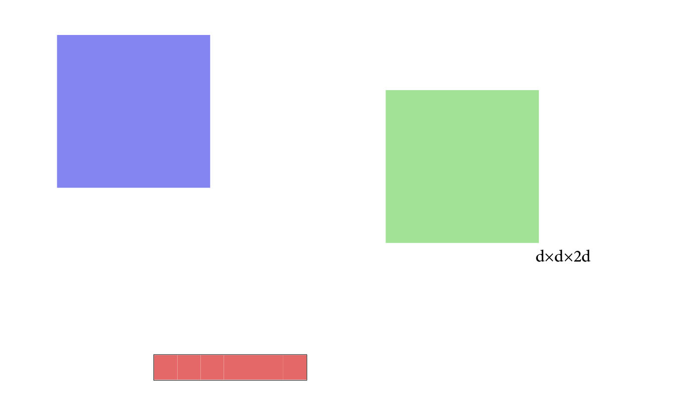
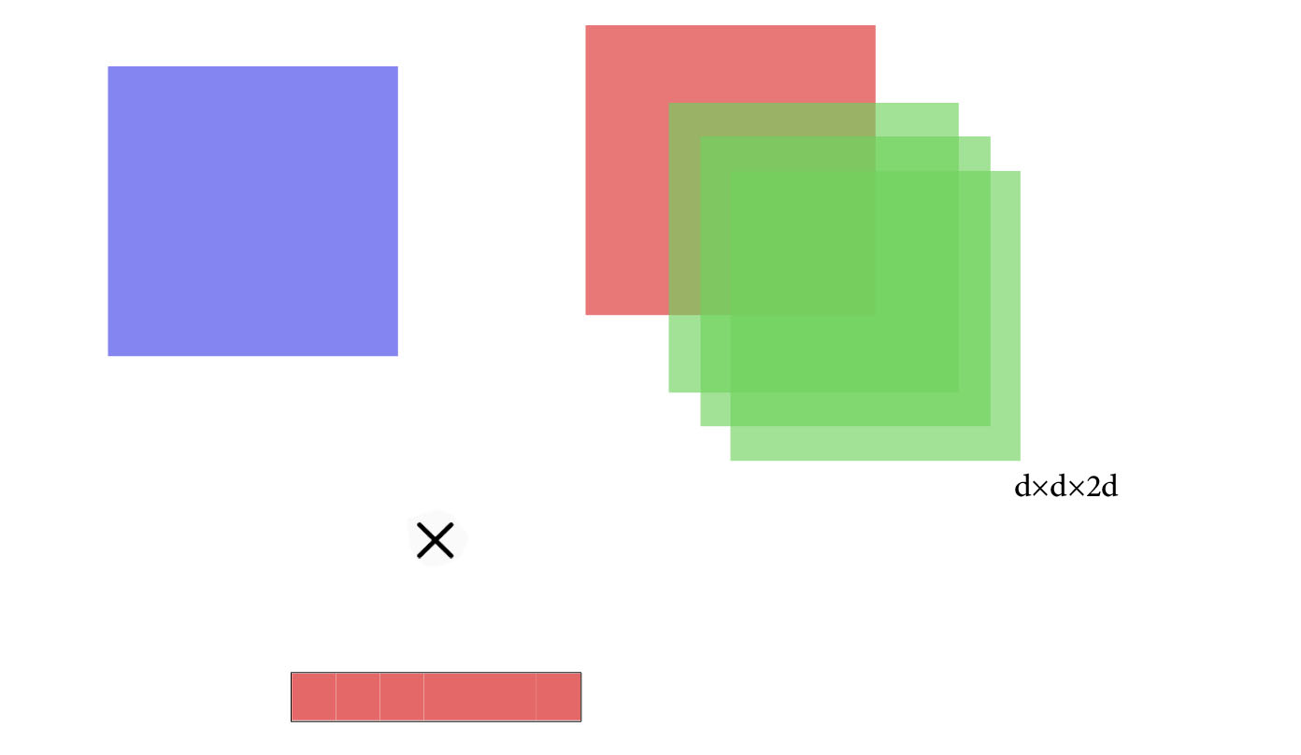
How RNN Works?
very
d*1
good
d*1
d*2d
2d*1
d*1

Slide 27
Related works
Word embedding
One hot vector
Co-occurrence Matrix
Word2vec (Tomas Mikolov, et al. 2013)
Text Analysis
Bag of Word (Pang & Lee, 2008)
Structure learning
Recurrent neural networks (Socher, 2011)
Matrix-Vector RNNs (Socher, 2012)
RNTN (Socher, 2013)
Notes:
Vecavg > 73.3
RNN > 79.0
RNTN > 80.7

Slide 28
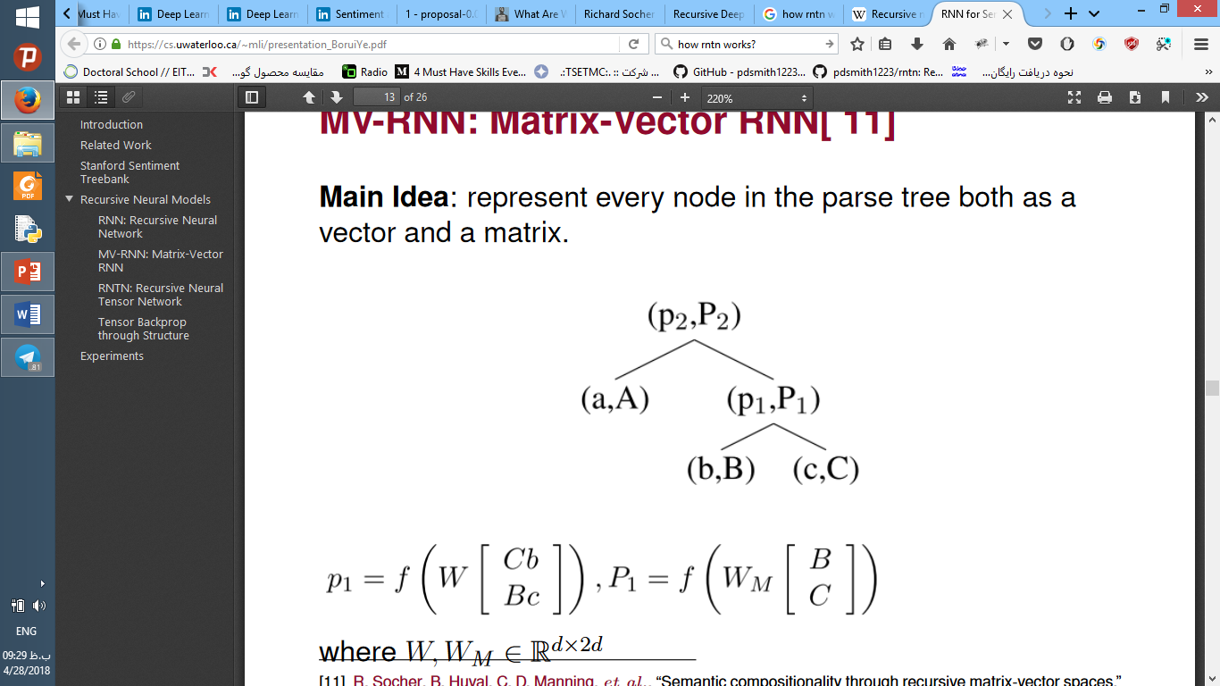
Matrix-Vector RNN
Each word is a (vector, matrix) pair
Recursive network to combine (b, B) and (c, C)
Single layer can model interactions

Slide 29
How MV-RNN Works?
good
very
d*d
d*1
very
good
d*d
d*2d
d*1
Notes:
باید از سمت راست یک بردار 2d*1 بدست بیاوریم

Slide 30
How MV-RNN Works?
good
very
d*d
d*1
d*2d

Slide 31
How MV-RNN Works?
d*1
d*2d

Slide 32
How MV-RNN Works?
d*1
very
good
d*d
d*2d
d*1

Slide 33
How MV-RNN Works?
d*1
d*2d
d*1

Slide 34
How MV-RNN Works?
d*2d
2d*1
d*1

Slide 35
How MV-RNN Works?
very
good
d*2d
2d*d
Notes:
باید از سمت راست یک بردار 2d*1 بدست بیاوریم

Slide 36
How MV-RNN Works?
very
good
d*2d
2d*d
d*d
Notes:
باید از سمت راست یک بردار 2d*1 بدست بیاوریم

Slide 37
Related works
Word embedding
One hot vector
Co-occurrence Matrix
Word2vec (Tomas Mikolov, et al. 2013)
Text Analysis
Bag of Word (Pang & Lee, 2008)
Structure learning
Recurrent neural networks (Socher, 2011)
Matrix-Vector RNNs (Socher, 2012)
RNTN (Socher, 2013)
Notes:
Vecavg > 73.3
RNN > 79.0
RNTN > 80.7

Slide 38
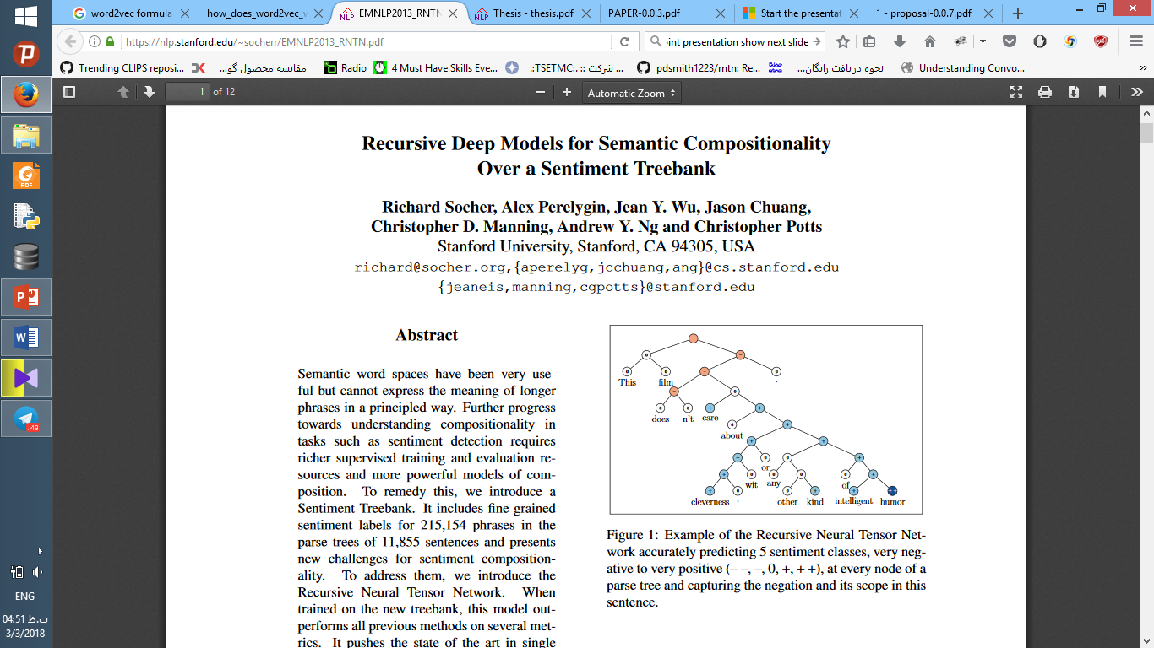


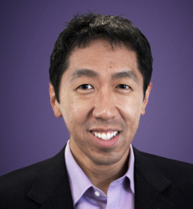
R. Socher
C. Manning
Andrew Ng
Notes:
ساکر و مانینگ 2013
هدف مقاله > طبقه‌بندی

Slide 39
Model classes
neutral
Positive
Somewhat positive
Negative
Somewhat Negative
Notes:
تشخیص قطیبت جملات و نگاشت آنها به 5 طبقه

Slide 40
Tree structure

Slide 41
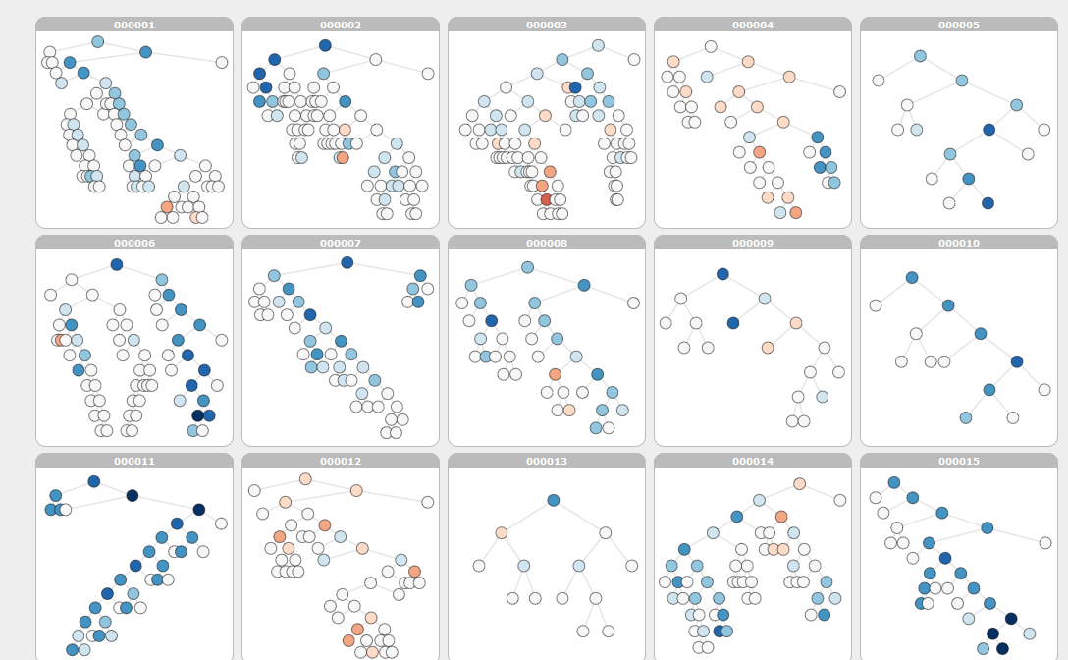

Slide 42
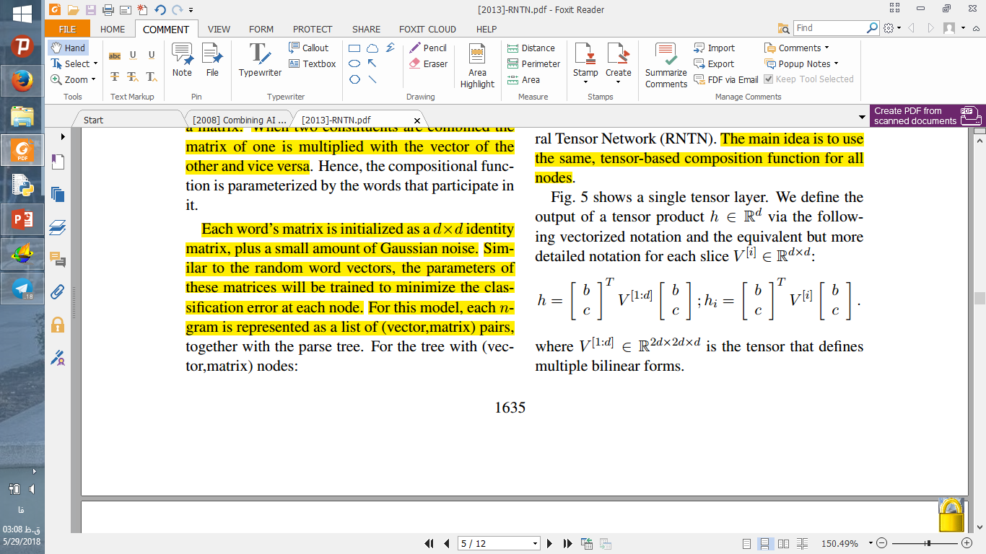
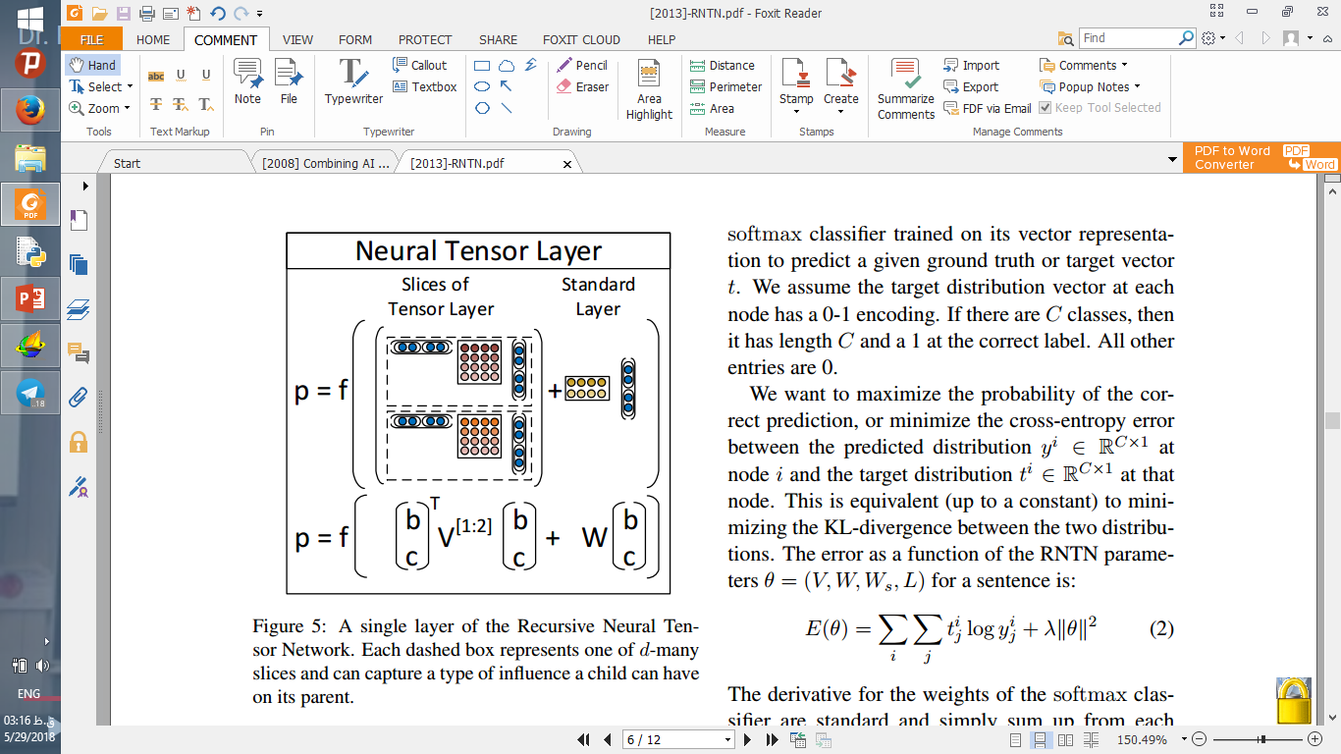
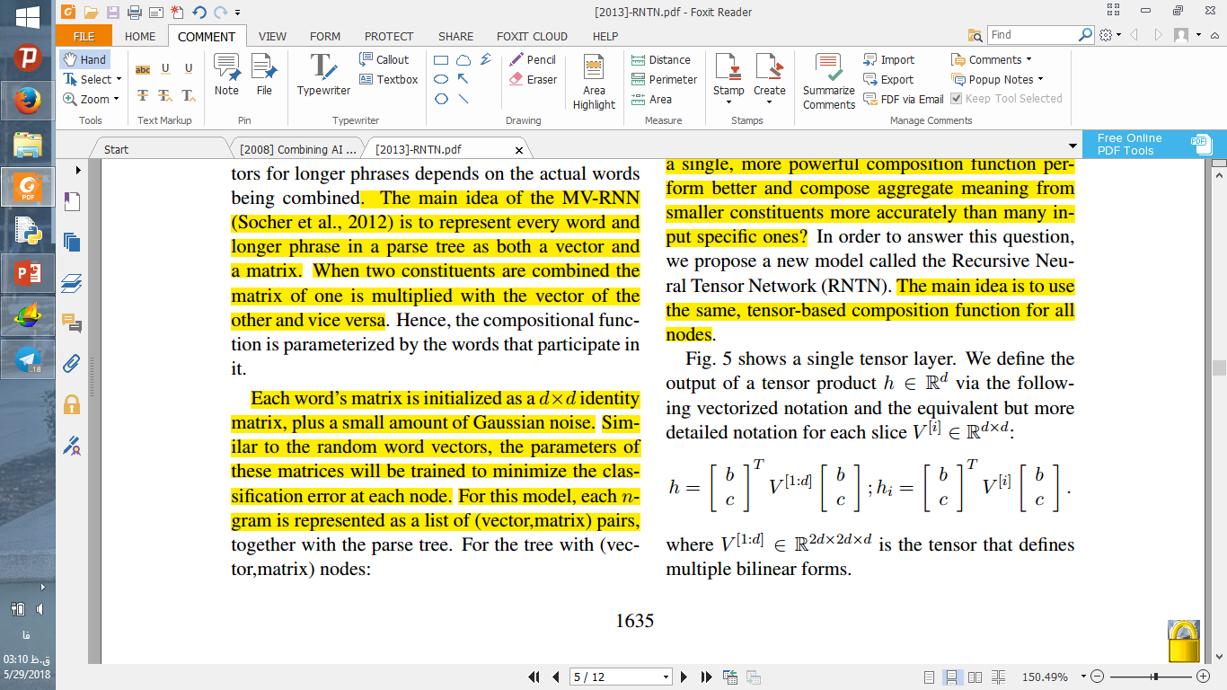
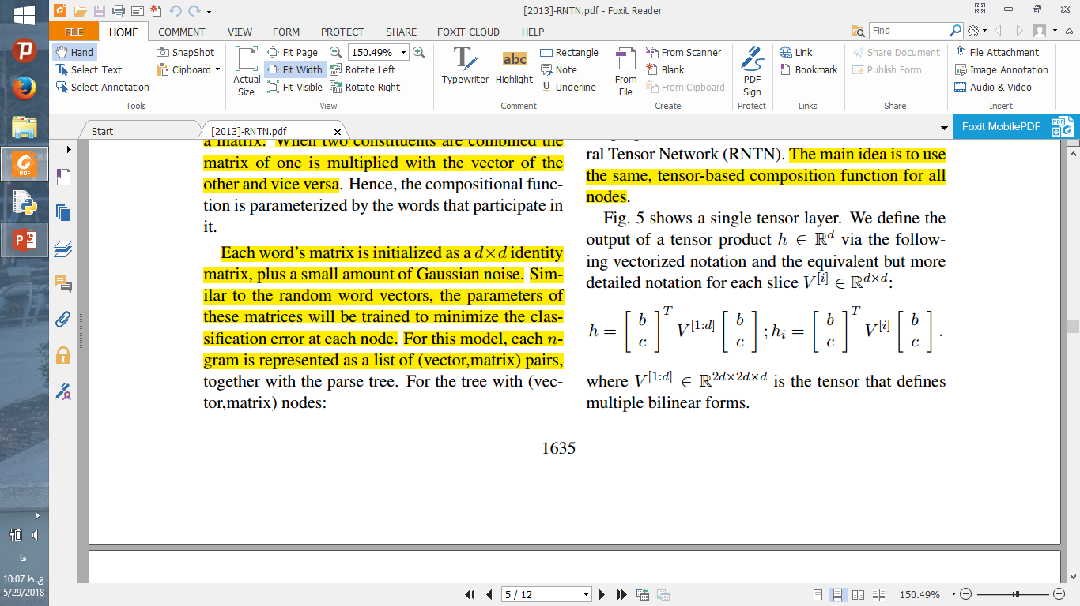
How Compositionality works?

Slide 43
How Compositionality works?

Slide 44
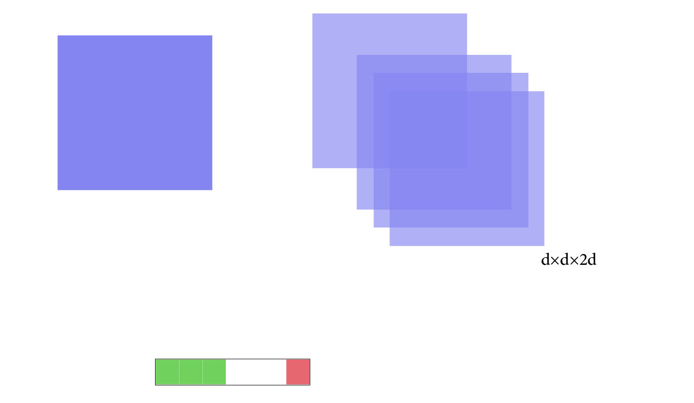
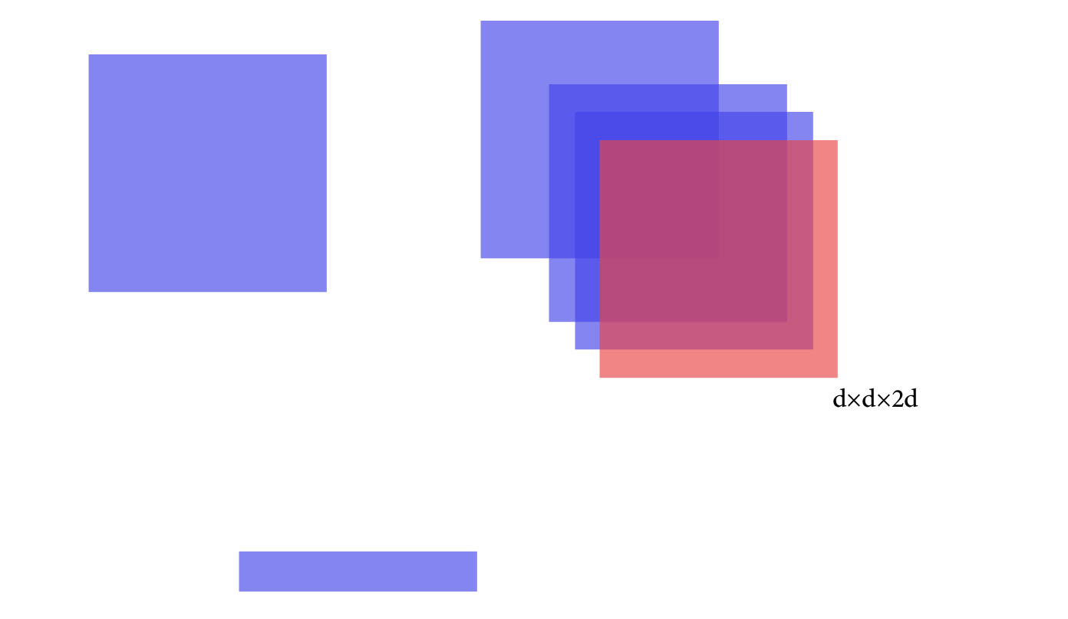
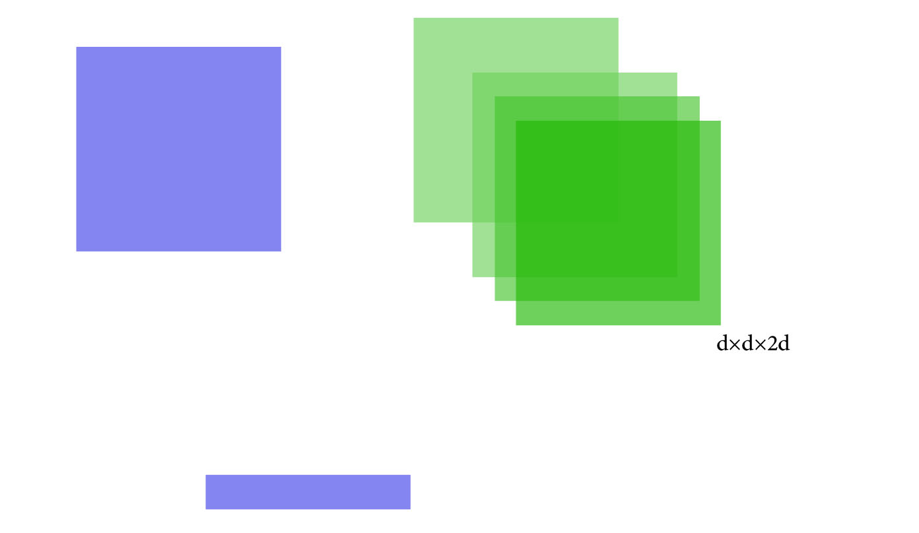
How Compositionality Works?
1*2d
2d*1
2d*2d*d
d*1

Slide 45

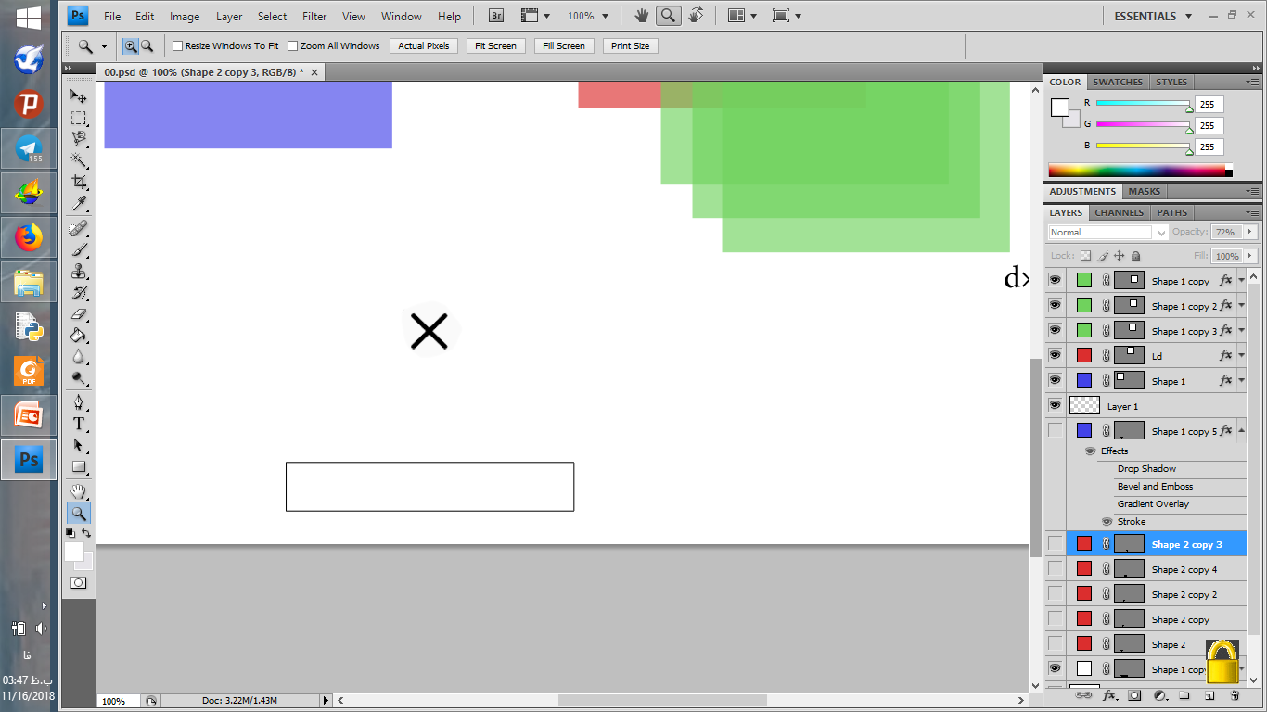
How Compositionality Works?
1*2d
2d*1
2d*2d
d*1

Slide 46
How Compositionality Works?
1*2d
2d*1
2d*2d
1*2d
d*1

Slide 47
How Compositionality Works?
1*2d
2d*1
2d*2d
1*2d
1*1
d*1

Slide 48
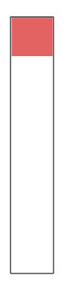
How Compositionality Works?
1*2d
2d*1
2d*2d
1*2d
1*1
d*1

Slide 49
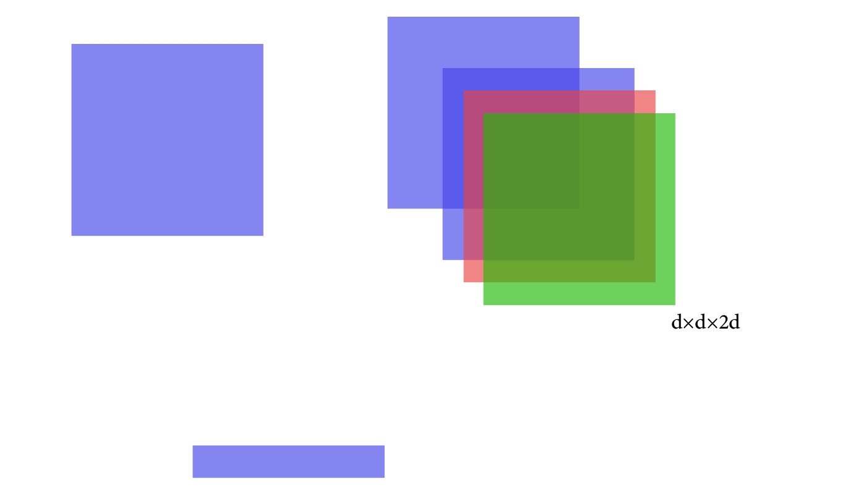

How Compositionality Works?
1*2d
2d*1
2d*2d
d*1

Slide 50
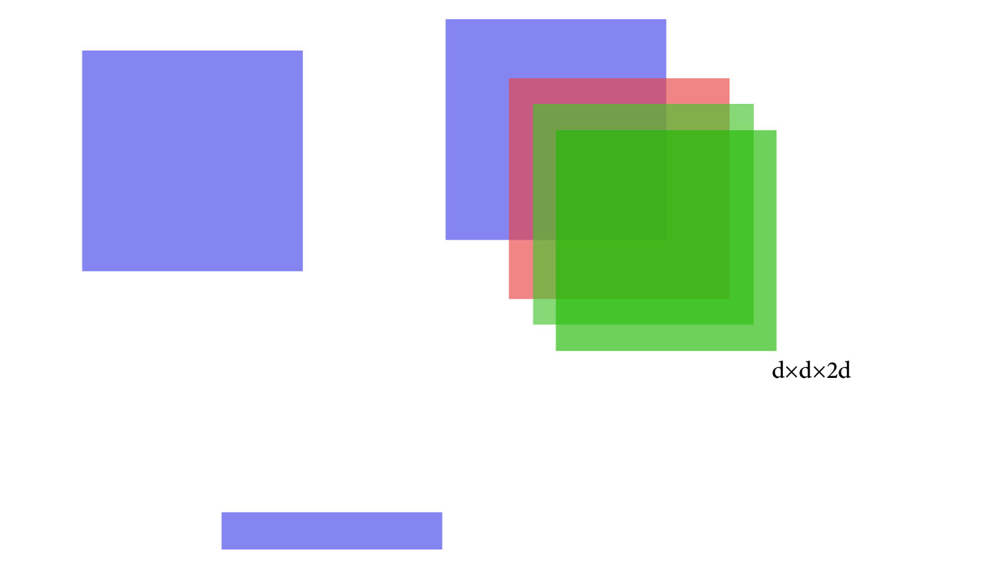

How Compositionality Works?
1*2d
2d*1
2d*2d
d*1

Slide 51
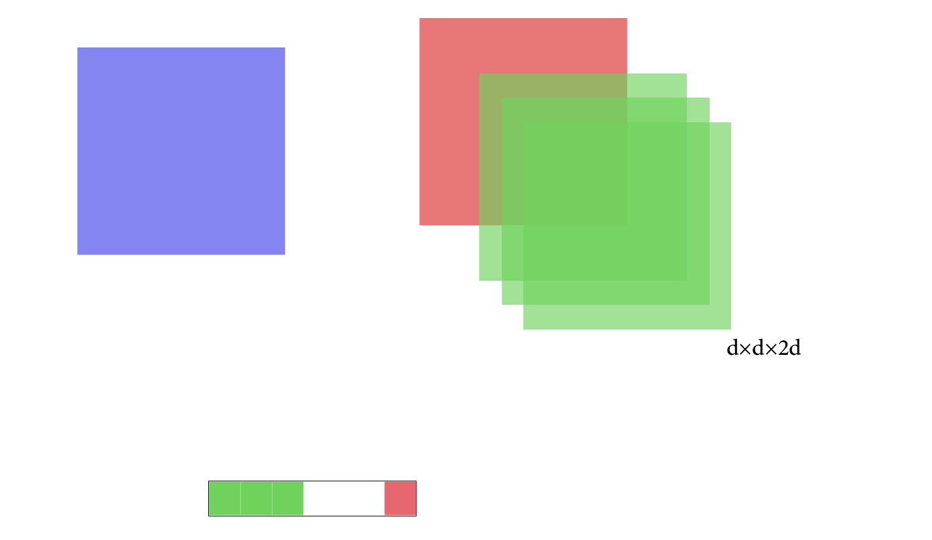

How Compositionality Works?
1*2d
2d*1
2d*2d
d*1

Slide 52
How Compositionality Works?
1*2d
2d*1
2d*2d
d*1

Slide 53
How Compositionality Works?
d*1
d*2d
2d*1
d*1

Slide 54
How Compositionality Works?
d*1
d*2d
2d*1
d*1
d*1

Slide 55
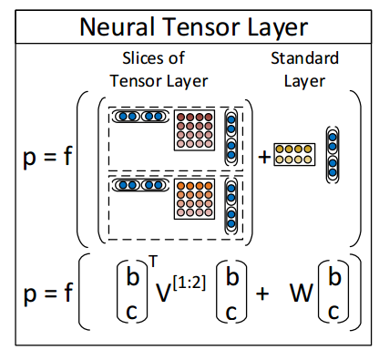
How Compositionality works?

Slide 56
Dataset details
Stanford sentiment treebank
Parse tree of 11.855 sentences
215.154 unique phrases with 5 classes labels via Mechanical Turk
Notes:
استنفورد پارسر
مکانیکال تورک آمازون
Rotentomatoes.com

Slide 57
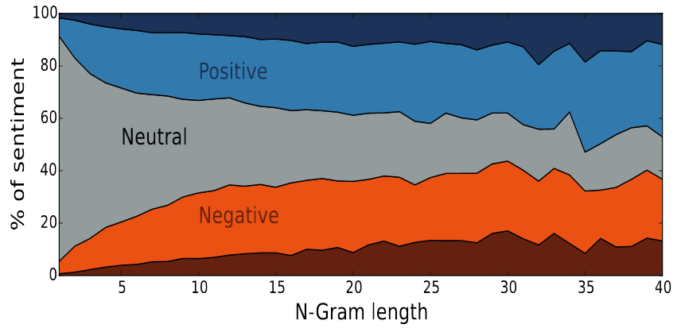
Dataset details
Normalized histogram of sentiment annotation at each n-gram length
Notes:
نمودار میزان پراکندگی قطبیت جملات

Slide 58
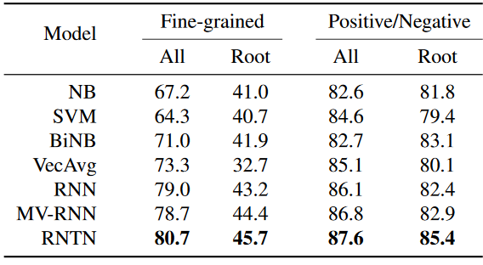
Compare

Slide 59
Conclusion
What is NLP?
What is Sentiment Analysis?
Why Sentiment Analysis?
Kinds of Sentiment Analysis
Sentiment Analysis Issues
Related works
RNTN Model

Slide 60
Resources
[1] Socher, Richard; Perelygin, Alex; Wu, Jean Y.; Chuang, Jason; Manning, Christopher D.; Ng, Andrew Y.; Potts, Christopher (2013). "Recursive deep models for semantic compositionality over a sentiment treebank". In Proceedings of EMNLP: 1631–1642.
[2]. Erk and S. Pad́ o. 2008. A structured vector space model for word meaning in context. In EMNLP
[3]. Socher, J. Pennington, E. H. Huang, A. Y. Ng, and C. D. Manning. 2011b. Semi-Supervised Recursive Autoencoders for Predicting Sentiment Distributions. In EMNLP
[4]. Mitchell and M. Lapata. 2010. Composition in dis-tributional models of semantics. Cognitive Science ,34(8):1388–1429
[5]. A. Plate. 1995. Holographic reduced representations. IEEE Transactions on Neural Networks , 6(3):623–641
[6]. Yessenalina and C. Cardie. 2011. Composi-tional matrix-space models for sentiment analysis. In EMNLP.
[7]. Zettlemoyer and M. Collins. 2005. Learning to map sentences to logical form: tructured classifica-tion with probabilistic categorial grammars. In UAI.
[8]. Bottou. 2011. From machine learning to machine reasoning. CoRR , abs/1102.1808.
[9]. E. Hinton. 1990. Mapping part-whole hierarchies into connectionist networks. Artificial Intelligence, 46(1-2).
[10]. B. Pollack. 1990. Recursive distributed representations. Artificial Intelligence, 46, November
[11]. Pang and L. Lee. 2008. Opinion mining and sentiment analysis. Foundations and Trends in Information Retrieval , 2(1-2):1–135.
[12]. Polanyi and A. Zaenen. 2006. Contextual valence shifters. In W. Bruce Croft, James Shanahan, Yan Qu, and Janyce Wiebe, editors, Computing Attitude and Af-fect in Text: Theory and Applications, volume 20 of The Information Retrieval Series , chapter 1

Slide 61
Thank you

